Slide 1
Engineering Mechanics
Spring Systems and Associated Work
LabRat Scientific
© 2019

Slide 2
What is Mechanical Work
WORK is done when a FORCE is applied over some DISTANCE.
Work = Force (N) x Distance (m)
The FORCE can come from any number of sources:
Gravity
Wind
Pressure
Springs
Etc…

Slide 3
Work has Direction
WORK can be either positive or negative.
WORK is positive when the force acts in the direction of the movement
Force
WORK is negative when the force acts against the direction of the movement
Force

Slide 4
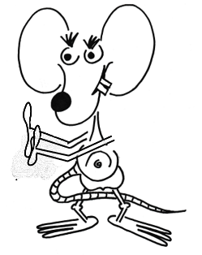
Work has Direction
Example: If Larry is trying to allow the ball to move down the ramp in a slow, controlled manner, he must apply a force to keep it from moving too fast. As such, Larry is doing negative work on the ball…
And gravity is doing positive work…

Slide 5
Hook’s Law
Hook’s Law is used to calculate the force generated by the compression, extension, or bending of a “springy” object like a rubber band, spring, or flexible rod. Hook’s Law is expressed as follows:
Force = Spring Constant (N/m) x Distance (m)
Force = k x
Relaxed Length (Force = 0)
Compressed Distance (x)
Compressed Distance

Slide 6
Determining the Spring Constant
The Spring Constant (k) can be determined by applying known forces to the spring and measuring how much the spring stretches.
0.0 m
0.1 m
1 N
0.2 m
1 N
If the force curve is linear, the slope of line represents the Spring Constant (k)
1 N

Slide 7
Determining the Spring Constant
Spring Constant = Slope
Rise
Slope = ----------
Run
2.0 N
Slope = ----------
0.2 m
Slope = 10 N/m
Spring Constant (k) = 10 N/m

Slide 8
Work Done by a Spring
The Area under the Force Curve represents the Potential Energy of the spring.
Energy is an objects “potential to do work”.
Area = Work
Work is the Change in Energy of the system.
This means that the area under the Force Curve also represents the Work that is done when the spring is released.

Slide 9
Work Done by a Spring
Potential Energy = Work that can
be done
PE = ½ x Base x Height
PE = ½ x 0.3 m x 3.0 N
Area = Potential Energy
= Work
PE = 0.45 Nm

Slide 10
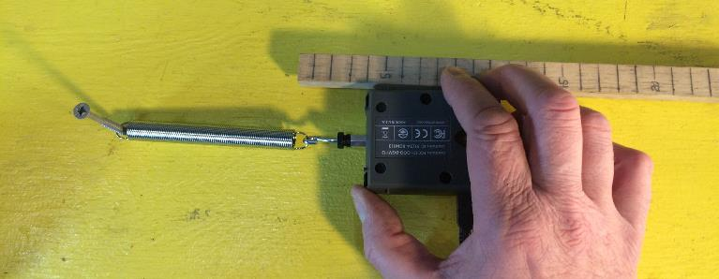
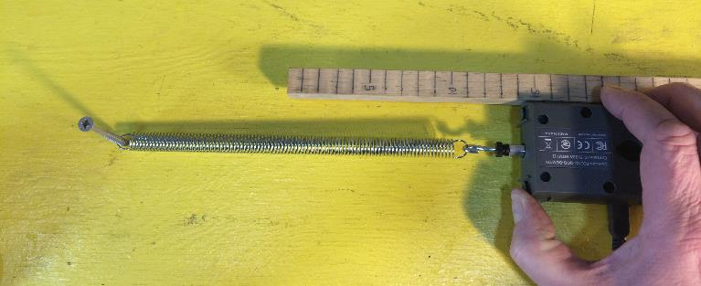
Spring Pull Experiment
SPRING
Stretch | Force
(m) | (N)
0 | 0
0.01 | 1.2
0.02 | 2.3
0.03 | 3.5
0.04 | 4.7
0.05 | 5.9
0.06 | 6.9
0.07 | 7.9
0.08 | 9.1
0.09 | 10.2
0.1 | 11.5
0.0 m stretch
0.1 m stretch

Slide 11
Spring Pull Experiment
From the data we can see the force is linear as the spring is stretched
Slope = 11.5 N / 0.1 m
= 115 N/m
Notice how the Spring Constant curve is horizontal indicating the spring constant is constant.
k = 115 N/m

Slide 12
Experimenters Beware…
When attempting to measure the spring force you should apply a small “preload” to the spring to get it to stretch a little before making measurements. This initial stretch eliminates any “mechanical slack” that might create an undesirable bias in the force data. This “preload force” needs to be subtracted from all the force measurements before the data is plotted. Preloading does not corrupt the spring constant calculations…
Here is some data from a test on a bungie cord. The cord was not pre-loaded before data was collected. You can see the bias that makes the force curve not pass through the origin (0.0 distance and 0.0 force).

Slide 13
Experimental Verification
In this experiment, we will measure the force-distance of the rubber band to determine the Potential Energy.
Rubber Band Spring
The Potential Energy is the amount of work that can be applied to the cart when the rubber band is released.
Applied Force
Cart Motion
The work the rubber band does on the cart will make the cart move creating Kinetic Energy.

Slide 14
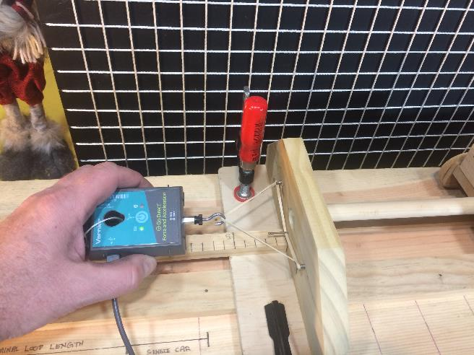
Experimental Verification
The rubber band was pulled using a load cell. The force-distance data that was collected is as follows:
Actual Test Data

Slide 15
Experimental Verification
The measured data was not quite linear,
The measured data was not quite linear, but it was straight enough so the area could be approximated using a simple right triangle.
The slope of the line (top of the triangle) represents the spring constant.
Area = ½ x Base x Height
Area = ½ x 0.1 m x 5 N
Area = 0.25 N*m
The area under the curve is the Potential Energy and the amount of work that the rubber band can do if it is released.
Work_{Rubber Band} = 0.25 N*m

Slide 16
Theoretical Computations
Potential Energy = Work that can be done
When the rubber band is released it can start performing work on the cart. As work is performed, the cart is accelerated and as the cart accelerates its kinetic energy increases.
The Work-Energy Theorem states:
The change in kinetic energy of a system is equal to the amount of work done on that object.
Mathematically speaking:
Work = Kinetic Energy_{Final} - Kinetic Energy_{Initial}

Slide 17
Theoretical Computations
If the object is initially at rest, the Work-Energy Equation becomes:
Work = Kinetic Energy_{Final} = ½ Mass x Velocity²
Algebra can be applied to the Work-Energy Equation to determine the theoretical velocity of the cart just when the rubber band becomes fully relaxed (Force=0):
Vel = ( 2 x Work ) / Mass
Vel = ( 2 x 0.25 N*m ) / 0.40 kg
Vel = 1.12 m/sec

Slide 18
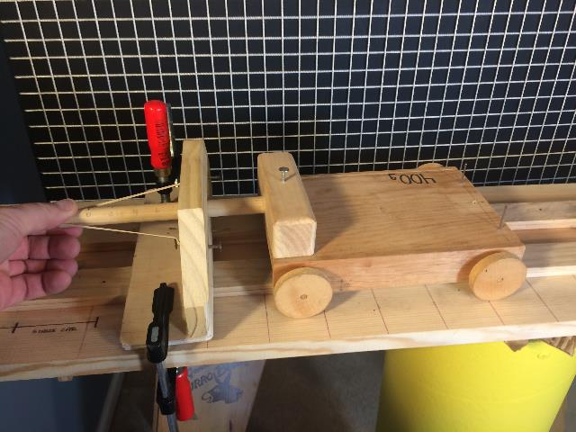
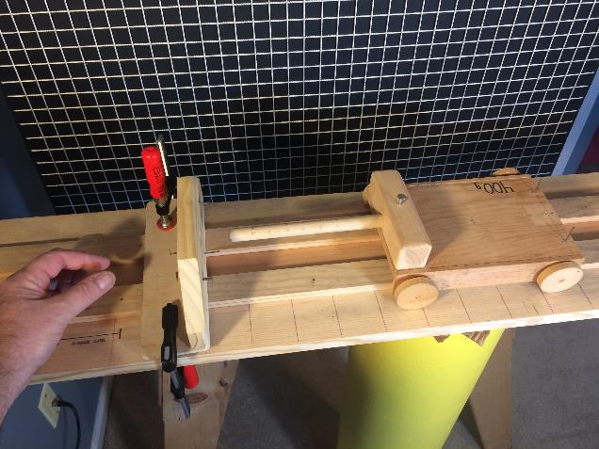
Rubber Band fully stretched (10 cm)
Force = 5.25 N
Cart Released
Force = 0 N

Slide 19
Experimental Results
A ultrasonic motion sensor was used to measure the velocity as a function of time during the test.
Alternate Data Collection Method: A ruler could have been placed along the track and then video frames could be counted to obtain velocity data…

Slide 20
Experimental Results
 | Cart Velocity
Theoretical | 1.12
Measured | 1.05
The variation between the theoretical result and the experimental result is about 5%. This is reasonable since the system is certainly not an “ideal” situation.

Slide 21
This series of experiments verify the governing equations for simple spring systems. The equations allow engineers to predict associated forces and kinetic responses to work being done on an object.

Slide 22
Questions ?

